Slide 1
Part 2 Chapter 7
Optimization

Slide 2
Chapter Objectives
Understanding why and where optimization occurs in engineering and scientific problem solving.
Recognizing the difference between one-dimensional and multi-dimensional optimization.
Knowing how to recast a maximization problem so that it can be solved with a minimizing algorithm.
Knowing how to apply the fminbnd function to determine the minimum of a one-dimensional function.
Being able to develop MATLAB contours and surface plots to visualize two-dimensional functions.
Knowing how to apply the fminsearch function to determine the minimum of a multidimensional function.

Slide 3
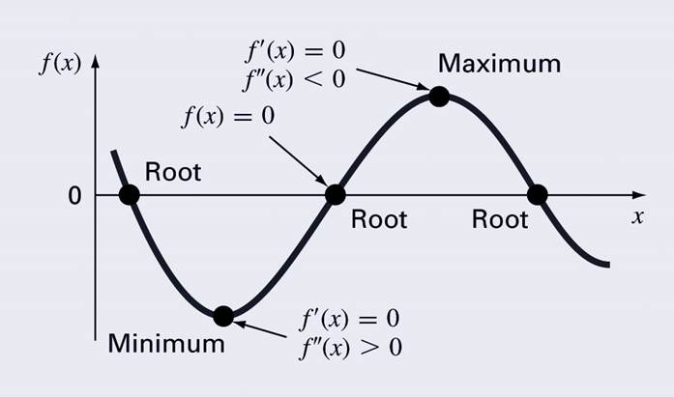
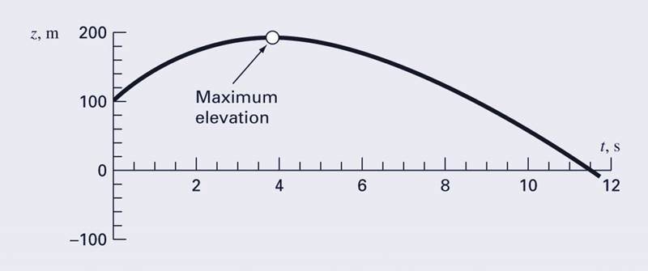
Optimization
Optimization is the process of creating something that is as effective as possible.
From a mathematical perspective, optimization deals with finding the maxima and minima of a function that depends on one or more variables.

Slide 4
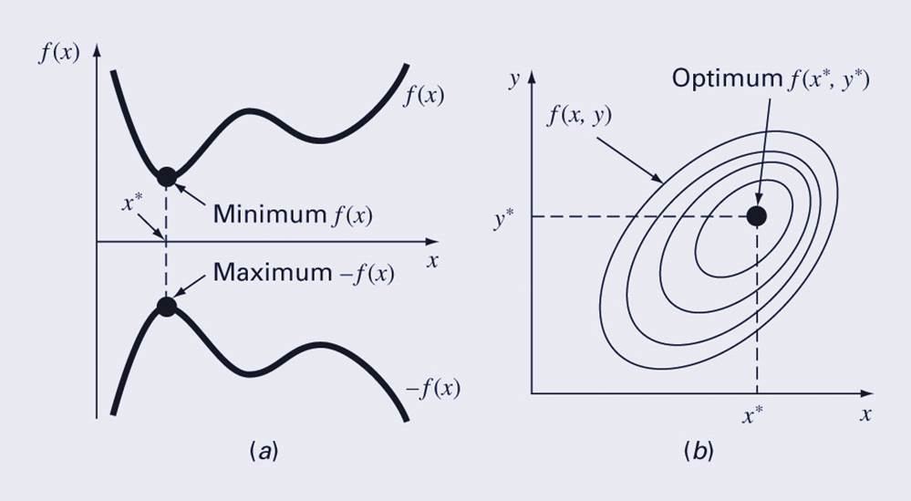
Multidimensional Optimization
One-dimensional problems involve functions that depend on a single dependent variable—for example, f(x).
Multidimensional problems involve functions that depend on two or more dependent variables—for example, f(x,y)

Slide 5
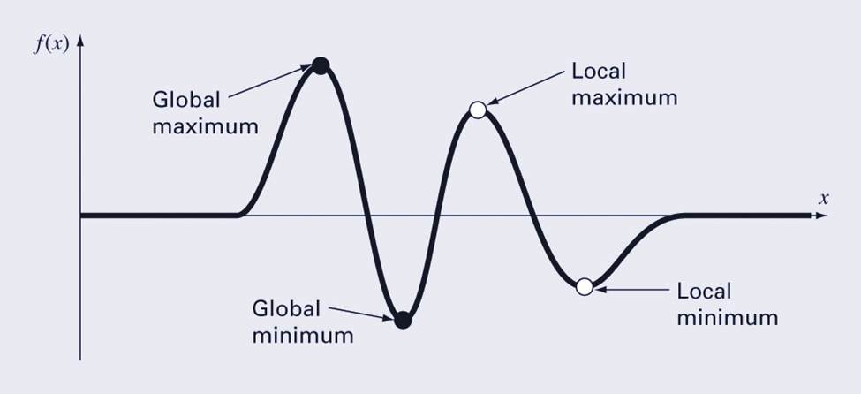
Global vs. Local
A global optimum represents the very best solution while a local optimum is better than its immediate neighbors. Cases that include local optima are called multimodal.
Generally desire to find the global optimum.

Slide 6
fminbnd Function – one dimensional optimization
MATLAB has a built-in function, fminbnd, which combines the golden-section search and the parabolic interpolation.
[xmin, fval] = fminbnd(function, x1, x2)
Options may be passed through a fourth argument using optimset, similar to fzero.

Slide 7
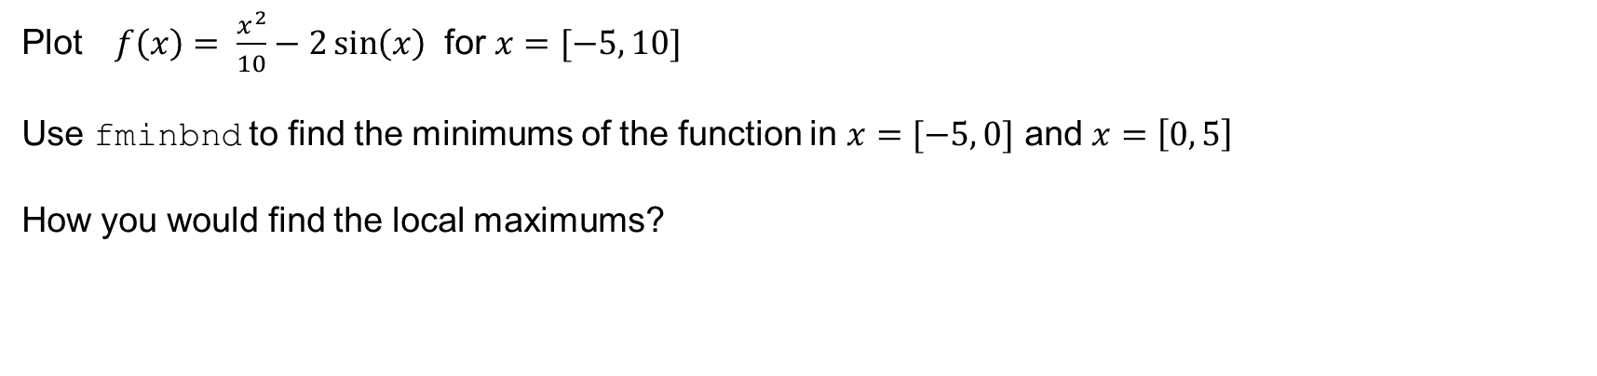
Example 7.3
Plot $f\left(x\right)= \frac{x^{2}}{10}−2\sin\left(x\right)$ for $x=[−5, 10]$
Use fminbnd to find the minimums of the function in $x=[−5, 0]$ and $x=\left[0, 5\right]$
How you would find the local maximums?

Slide 8
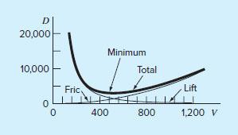
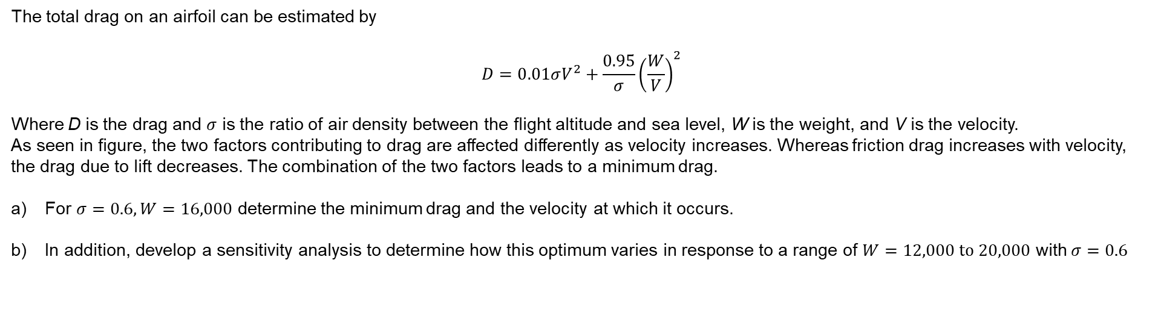
Problem 7.35
The total drag on an airfoil can be estimated by
$$D=0.01σV^{2}+\frac{0.95}{σ}{\left(\frac{W}{V}\right)}^{2}$$
Where D is the drag and $σ$ is the ratio of air density between the flight altitude and sea level, W is the weight, and V is the velocity.
As seen in figure, the two factors contributing to drag are affected differently as velocity increases. Whereas friction drag increases with velocity, the drag due to lift decreases. The combination of the two factors leads to a minimum drag.
For $σ=0.6, W=16,000$ determine the minimum drag and the velocity at which it occurs.
In addition, develop a sensitivity analysis to determine how this optimum varies in response to a range of $W=12,000 to 20,000$ with $σ=0.6$

Slide 9
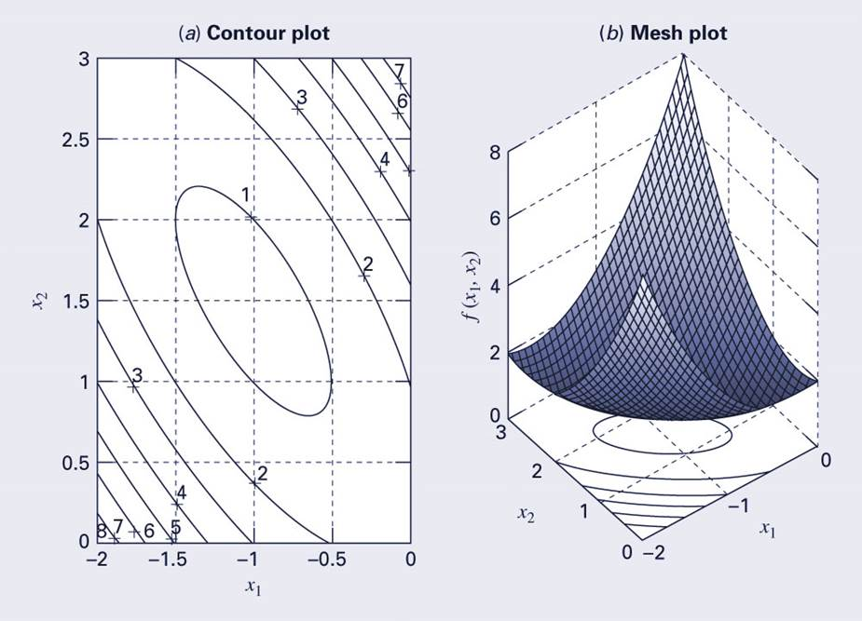
Multidimensional Visualization
Functions of two-dimensions may be visualized using contour or surface/mesh plots.

Slide 10
fminsearch function, multidimensional optimization
MATLAB has a built-in function, fminsearch, that can be used to determine the minimum of a multidimensional function.
[xmin, fval] = fminsearch(function, x0)
xmin in this case will be a row vector containing the location of the minimum, while x0 is an initial guess. Note that x0 must contain as many entries as the function expects of it.
NOTE:
The function must be written in terms of a single variable, where different dimensions are represented by different indices of that variable.

Slide 11
fminsearch function, multidimensional optimization
To minimize f(x,y)=2+x-y+2x²+2xy+y² rewrite as f(x₁, x₂)=2+x₁-x₂+2(x₁)²+2x₁x₂+(x₂)²
f=@(x) 2+x(1)-x(2)+2*x(1)^2+2*x(1)*x(2)+x(2)^2 [x, fval] = fminsearch(f, [-0.5, 0.5])
Note that x0 has two entries - f is expecting it to contain two values.
MATLAB reports the minimum value is 0.7500 at a location of [-1.000 1.5000]

Slide 12
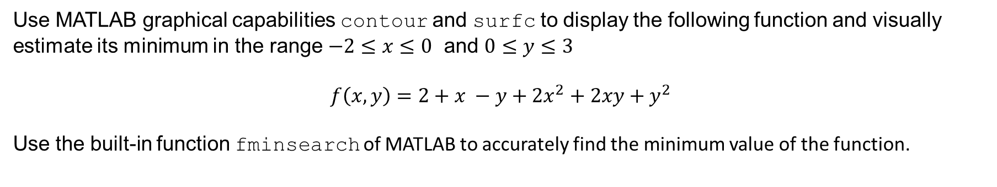
Example 7.4
Use MATLAB graphical capabilities contour and surfc to display the following function and visually estimate its minimum in the range $−2≤x≤0$ and $0≤y≤3$
$$f\left(x,y\right)=2+x −y+2x^{2}+2xy+y^{2}$$
Use the built-in function fminsearch of MATLAB to accurately find the minimum value of the function.

